Slide 1
Introduction to PRINCE2 Agile
Dr Rob Baxter
Dr Amy Krause

Slide 2

Reusing this material
This work is licensed under a Creative Commons Attribution-NonCommercial-ShareAlike 4.0 International License.
https://creativecommons.org/licenses/by-nc-sa/4.0/
This means you are free to copy and redistribute the material and adapt and build on the material under the following terms: You must give appropriate credit, provide a link to the license and indicate if changes were made. If you adapt or build on the material you must distribute your work under the same license as the original.
Acknowledge EPCC as follows: “© EPCC, The University of Edinburgh, www.epcc.ed.ac.uk”
Note that this presentation contains images owned by others. Please seek their permission before reusing these images.

Slide 3
What is an Agile Method?
A set of principles and practices which enable a team to develop software quickly and respond to change
Software is developed with continuous feedback on quality and requirements
Often seen as an alternative to the ‘waterfall model’ and its many variations
Extreme Programming (XP) is a well-known agile method, but there are many others

Slide 4
What is PRINCE2?
PRojects IN Controlled Environments version 2
A project management standard produced originally by the UK
Government (1996)
“PRINCE2 is a process-based approach for project management providing an easily tailored, and scalable method for the management of all types of projects”
PRINCE2 is a de facto UK PM standard
Mandatory in the public sector (Gov, NHS, Police)
A PM method of choice in business
Unilever, GSK, Tesc o, BT, Oracle, Lloyds Baking Group, RBS, Centrica, Cable & Wireless...
Widespread in Europe and beyond, too
PRINCE2 is internationally recognised and respected
Most recent update 2017

Slide 5
What PRINCE2 is not
PRINCE2 is not a software engineering method!
But it grew out of an IT environment
And it fits well with traditional or Agile development methods alike
PRINCE2 will not help you code better
But it will help you deliver better quality products, on time
And will stop you falling out with your boss/staff
PRINCE2 will not tell you how to write software
But it will leave you alone to write software your way
PRINCE2 is not a silver bullet
There are no silver bullets, of course ☺
But it’s general, flexible and tailorable and – most importantly – it’s based on common sense

Slide 6
Criticisms of PRINCE2
“PRINCE2 is too heavyweight”
Then you’re doing it wrong! This misses the principle of tailoring!
“PRINCE2 does not address Requirements Management or Requirements Development... [or] the way the Technical Solution should be built nor does it have processes for Verification or Validation of a product”
Well spotted! It’s a project management method, not a software engineering method
“PRINCE2 manages change as something that must be “controlled”, not “embraced” ”.
Umm, nope! PRINCE2 says “change happens, so plan for it”

Slide 7
PRINCE2: 7 Principles
Projects have a clear Business Case or they don’t happen
“Remind me again why we’re doing this project?”
Defined roles & responsibilities at corporate, Board, Project and Team levels
Each level has a clearly defined interface with the others
Projects run in Stages with clearly defined Stage Boundaries
A beginning, middle and end with clear milestones to stop and review progress
Management by exception against defined Tolerances
If there are no problems, just carry on – management don’t meddle
Product-Based Planning focuses on products not tasks
Think “what things do we have to build?”
Tailoring!
One size does not fit all! Tailor the processes to your own project’s needs
Learn from experience
Don’t repeat the same mistakes as last time

Slide 8
PRINCE2: Themes
Business Case
“Why are we doing this project? Where’s that written down?”
Organisation
“Who is responsible for which bits? Who’s in charge? Where’s the org chart?”
Quality
What’s our “definition of done”? Build quality and test into the build process
Plans
Product-based planning, focused on things with defined quality
Risk
“What might go wrong? How do we avoid it? What should we do if it does?”
Change
Plan to manage change, because it will happen!
Progress
”What’s the status? Are we on track? Are we on budget?”

Slide 9
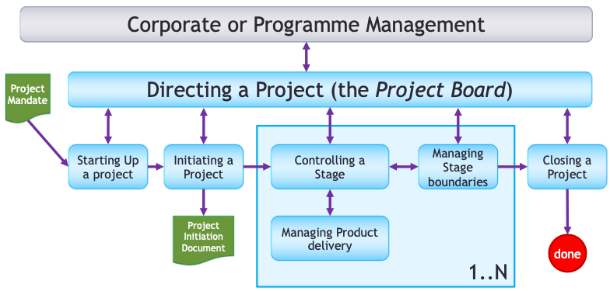
The PRINCE2 process diagram
+planning
+change management
+risk management

Slide 10
MP & software engineering methods
Most of PRINCE2 happens “above” the developer
So it doesn’t meddle with how you do things
PRINCE2’s product breakdown focus is a good fit for software
Products can (indeed should) be quite small
1-2 week size of work package = size of Agile/XP iteration
PRINCE2’s assumption of change fits agile methods well
Each work package can address 1-2 requirements with replanning in between – a very “user story” approach
One thing PRINCE2 does demand is: “build quality in”
Quality and quality checks should be a fundamental part of MP
Good match with test-driven development and developer-test culture
Test is good, code review is good

Slide 11
The PRINCE2 process diagram

Slide 12
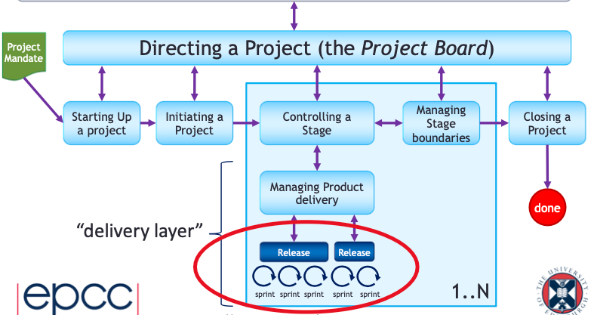
The PRINCE2 process diagram
Agile
See https://prince2agile.wiki/

Slide 13
Agile Motivation
Balancing time, cost, quality and scope
Cost: Often constrained, hard to trade for time (usually attempted by adding or removing people from a team)
Time: Usually constrained by the nature of a project
Quality: Hard to trade off, and not desirable – decreasing quality can reduce cost and time
Scope: Can be reduced to increase quality, decrease cost & time
Focus on scope as it is easy to control
Don't compromise on internal quality
This means code quality, not necessarily user visible quality
Controlling scope == delivering what the customer wants

Slide 14
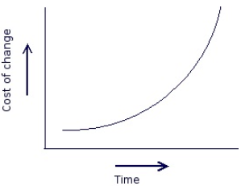
Waterfall model cost of change
Cost of change increases as project proceeds
Later in the project requirements may change and bug fixes may be required
This will be expensive

Slide 15
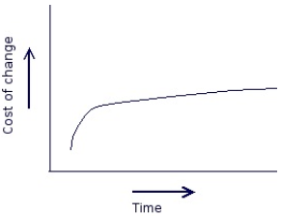
Extreme Programming (XP) cost of change
Adopt practices which keep cost of change low
Requirements change is possible at any stage, and bug fixes are cheaper

Slide 16
12 Practices of XP
Small Releases
Testing
Collective Ownership
On-site Customer
Metaphor
Refactoring
7. Continuous Integration
8. Coding Standards
9. Simple Design
10. Pair Programming
11. Sustainable Pace
12. Planning Game

Slide 17
An XP Iteration
Lasts for 1-2 weeks
Begins with a Planning Meeting
This takes about a day
The rest of the iteration is taken up with development work
Practices: Short Releases

Slide 18
An XP Day
Stand-up meeting lasting ~15 minutes
Report progress of current tasks
Briefly plan next set of tasks
Share knowledge relevant to current development tasks
Find others to pair up with, and work on tasks
All work in one room so it’s easy to start discussions and ask questions
Stories and tasks are displayed on a notice board visible to all
Go home on time!
Practices: Pair Programming, Collective Ownership, Simple Design, Sustainable Pace

Slide 19
Criticisms of XP
‘XP is hard’ — Kent Beck, Extreme Programming Explained
If the domain isn’t well understood, it’s hard to have a ‘customer’
May need formal documentation — regulatory requirements
Some developers don’t like XP
Don’t like pair programming
Trained in a different way of working
Changing the development process can have a huge cost
The cost may be much greater than the benefit

Slide 20
When not to use XP
XP is hard to scale, practical team size limit is ~15
The team must have someone who is able to represent the customer on-site
Where there are a set of customers, or conflicting stakeholder interests, this can be difficult
The customer must be willing to renegotiate the scope of the project
XP may not fit with an organisation’s culture

Slide 21
Other Agile Methods
Overview: the Agile Alliance https://www.agilealliance.org
Scrum
https://www.scrum.org/
Kanban
https://en.wikipedia.org/wiki/Kanban_(development)
Crystal
https://www.geeksforgeeks.org/crystal-methods-in-agile-development- framework/
Scrumban (no, really)
... and many more!

Slide 22
Make your own
It’s in the spirit of Agile methods to change a process if you need to
All of these methods (XP, Scrum, Crystal) encourage project managers and developers to look for ways to improve the way they work
Even if that means you’re not doing “real XP” any more

Slide 23
Conclusion
PRINCE2 is a powerful, flexible, scalable PM approach
based on industry best practice
rooted in software development projects
provides good, intelligent layers of management control
Agile methods aim to make (software) product delivery more efficient
make development responsive to customers
and responsive to change, which always happens!
PRINCE2 management and Agile development fit well together
cf.“PRINCE2Agile”
Good jumping off points
https://en.wikipedia.org/wiki/PRINCE2
https://en.wikipedia.org/wiki/Agile_software_development
https://prince2agile.wiki/

